Slide 1

CONCEPTS OF PROGRAMMING LANGUAGES
12th Edition
Chapter 14
Exception Handling
and Event Handling

Slide 2
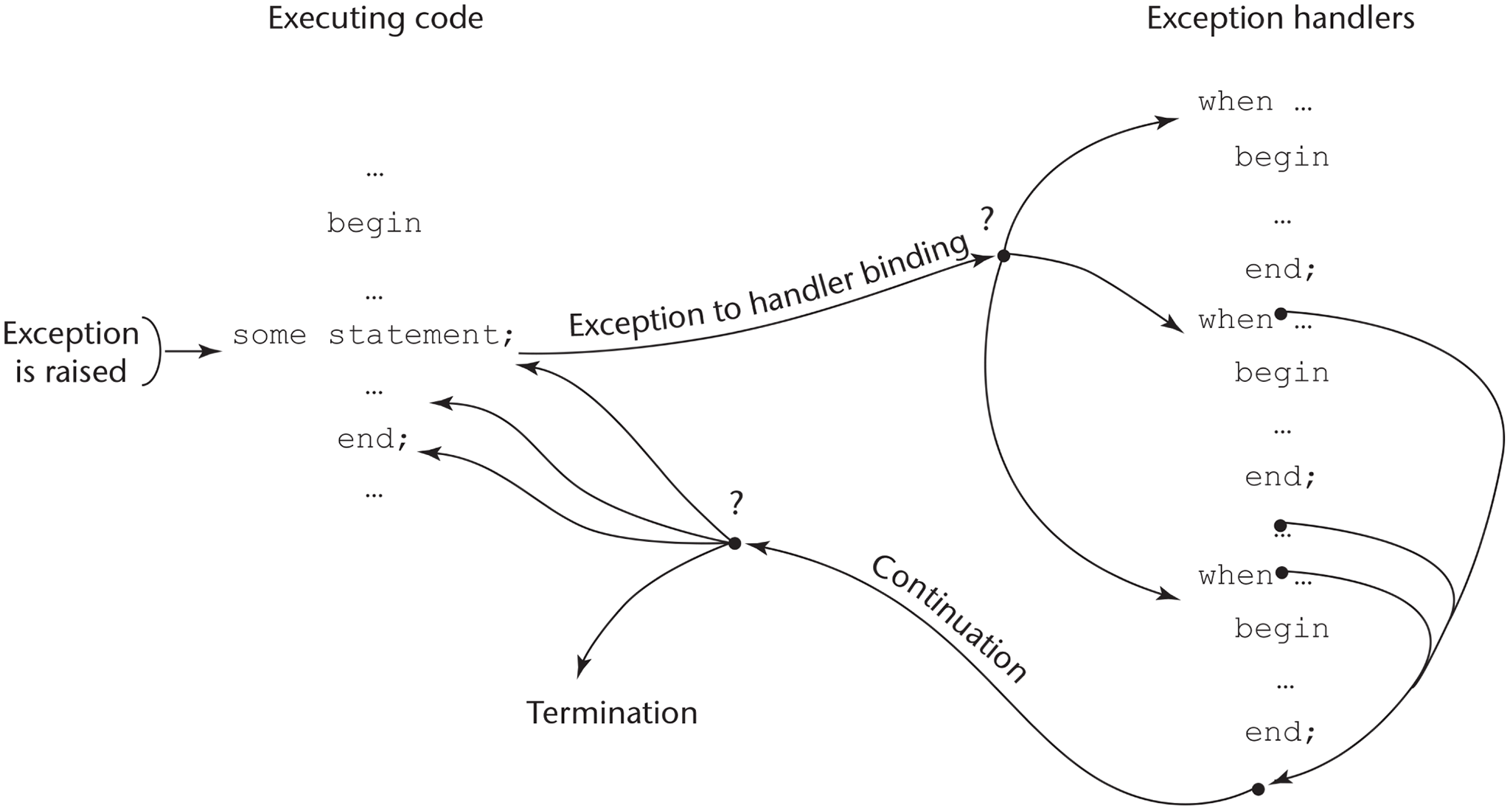
Figure 14-1 Exception-handling control flow

Slide 3

Figure 14-2 Output of RadioB.java
Source: Java radio applet screenshot.

